Slide 1


1

Slide 2
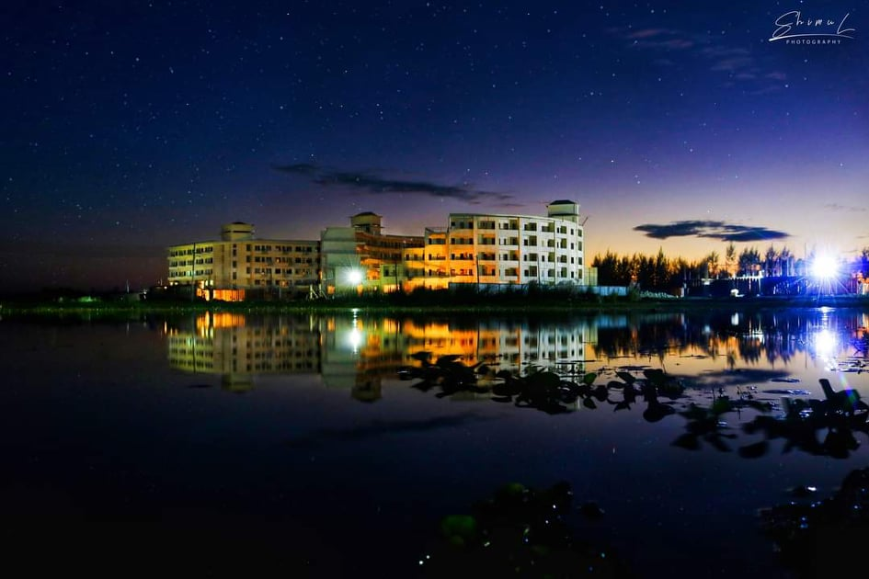
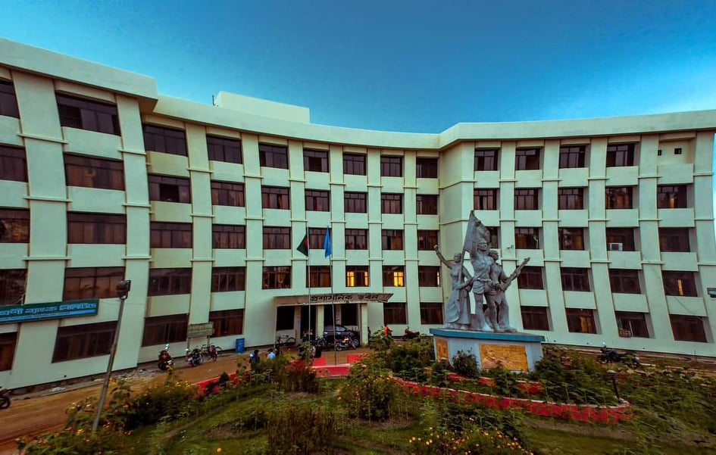
Active Student’s
Active Teacher’s
3000+
200+
Living Facilities
No Living Facilities
75-80%
20-25%
2

Slide 3

3

Slide 4

4

Slide 5
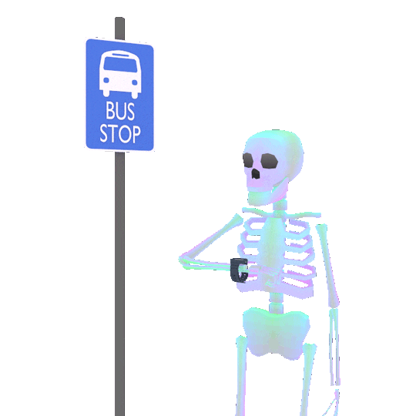
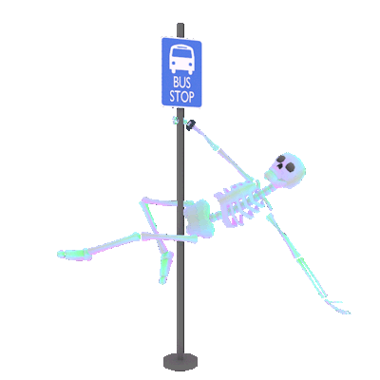
5

Slide 6
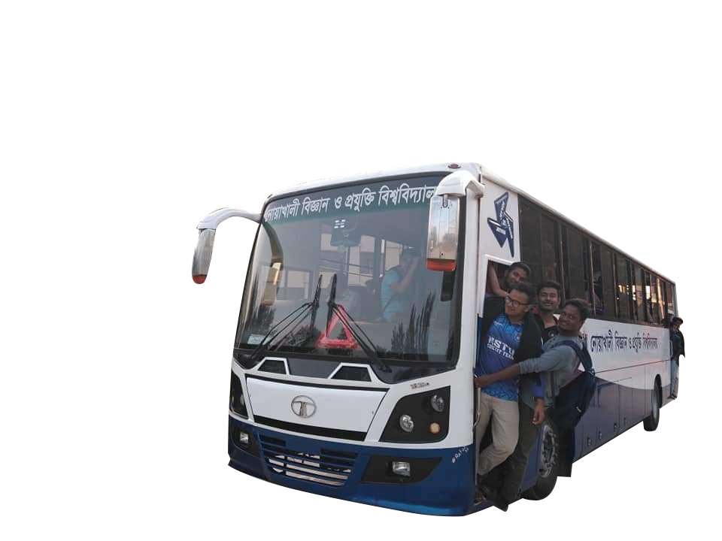

6

Slide 7
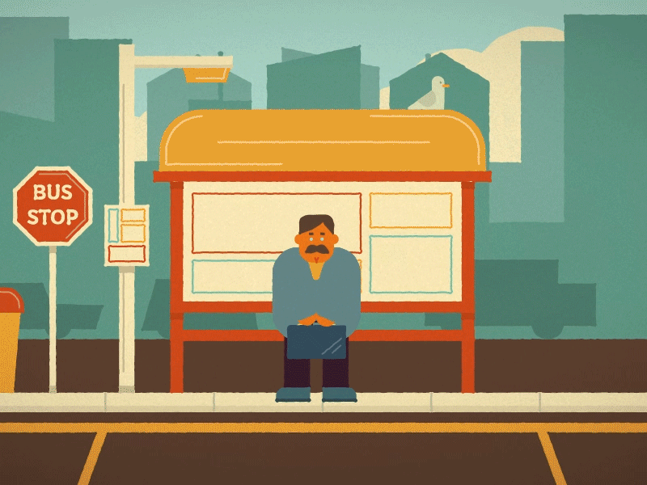
7

Slide 8
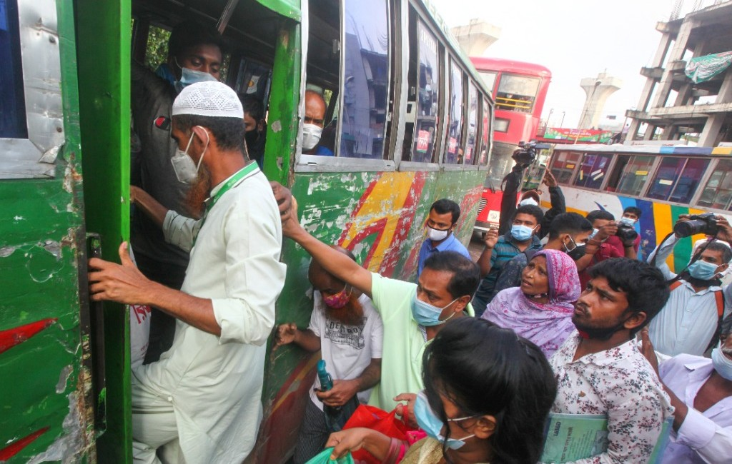
Extra Money
Sometimes Not Found any local transport
Not Reached at time
Physical Harassment
8

Slide 9

“NSTU
Bus Tracking System”

Slide 10

HOME
Supervisor
Auhidur Rahman Sumon
MARTIN PETER
Assistant Professor & Director(Acting)
IIT-NSTU
10

Slide 11




Meet the Team
Md AL ADNAN
Moon moon das
Md.Faisal ahammed
MUH1825008M
BKH1825013F
ASH1825015M
@aladnansami
@moonmoondas
@faisalahammed
Notes:
© Copyright Showeet.com – Creative & Free PowerPoint Templates

Slide 12

Objectives
To build a system which will track the current position and direction of the bus and show it to the user who wants to travel by the bus.
To give the proper and accurate information about the bus to the user.
To reduce the waiting time for travelling.
To ensure the necessary security of information and other processes.
12

Slide 13

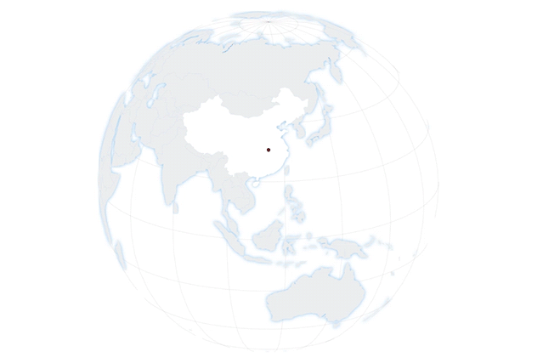

Requirement Collection
No Physical Requirement Collection

Slide 14
Software Requirement
Technology used
Database Tools
01
Android Operating System 2.3 ("Gingerbread") or higher
Firebase, cloud DB, Tiny DB, Google sheet
04
02
IDE Tools
Compatible Operating System
05
MIT App Inventor
Windows,MAC,Linux,OS,Android
03
Back-End
Front-End
06
Block Cloud Programming Language
MIT App Inventor SDK , Java block Codding
14

Slide 15

Hardware Requirement
01
Mobile Processor
02
Hard-Drive
1GHZ or higher
10gb And More
03
System Processor
Dual core and above
15

Slide 16


Functional Requirement
Mapping with the position data retrieved from bus positioning module
Allow user retrieve information from mobile device
Save record of users that what is their location
Show information to user in real time
Store the user information in database
Store the bus information in database
Show the bus position in a map view to user
Process the position data received from bus positioning module
16

Slide 17

Non- Functional Requirement
Performance Requirement
Dependability Requirements
Security Requirements
Showing the bus position in a map view must be faster.
Showing the bus position in a map view must be accurate.
The system will handle thousands of data .
The system must be available on time.
The system handles all user access without system errors .
Signing in with an educational email in a student/teacher module .
Email verification.
Get access according to logged in user.
Signing out as a student/teacher.

Slide 18
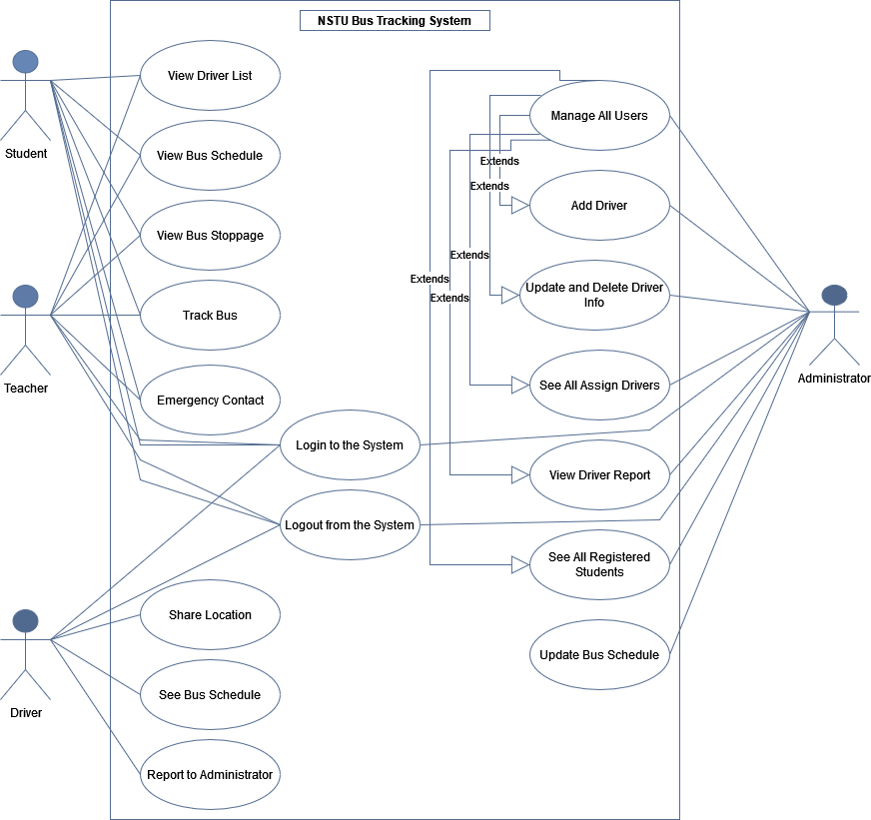
‘System Design’
1.Use Case Diagram

Slide 19
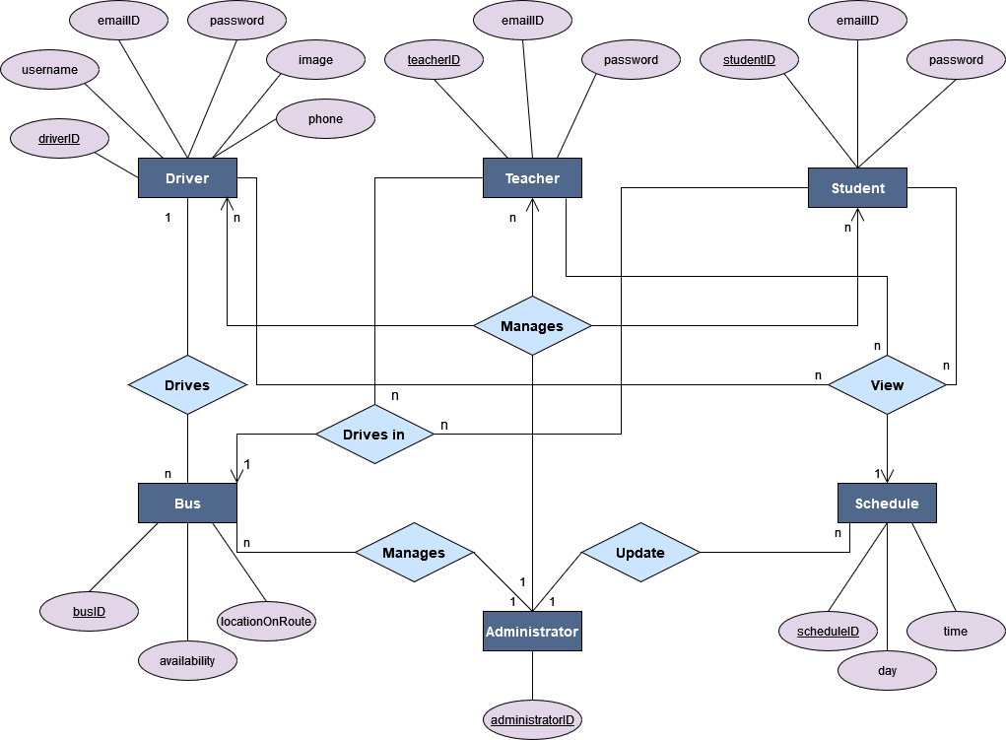
‘System Design’
2.E-R Diagram

Slide 20
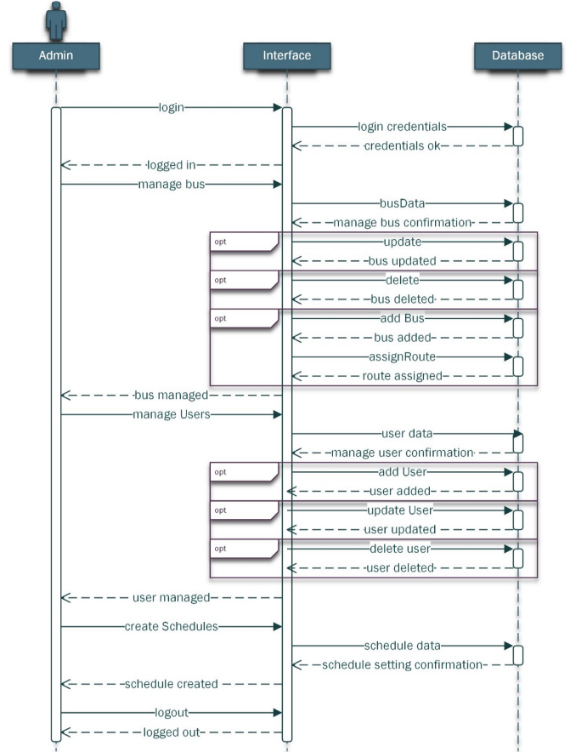
‘System Design’
3.Sequence Diagram

Slide 21
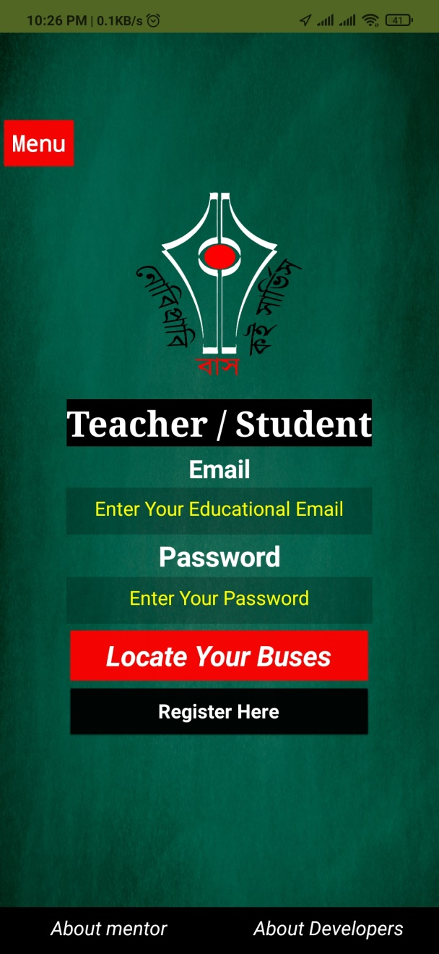
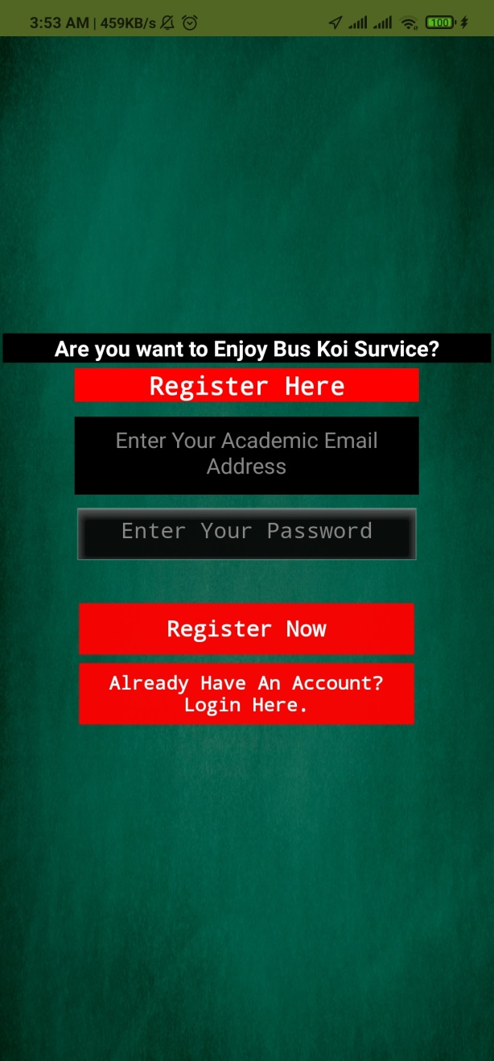
‘User Manual’
(Student & Teacher)Perspective

Slide 22
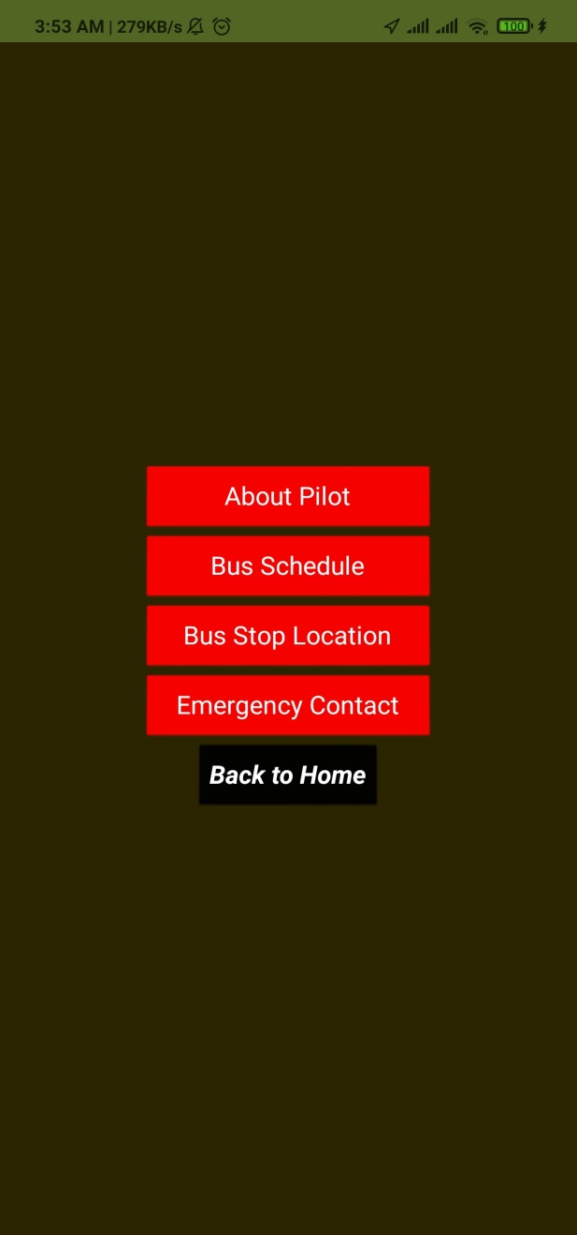
‘User Manual’
(Student & Teacher)Perspective

Slide 23

‘User Manual’
(Student & Teacher)Perspective

Slide 24

‘User Manual’
(Student & Teacher)Perspective

Slide 25
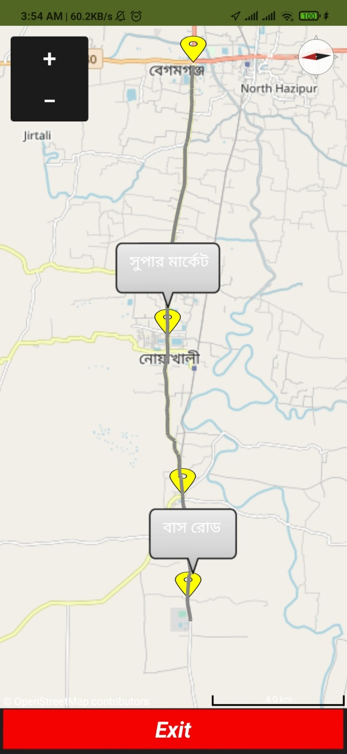
‘User Manual’
(Student & Teacher)Perspective

Slide 26
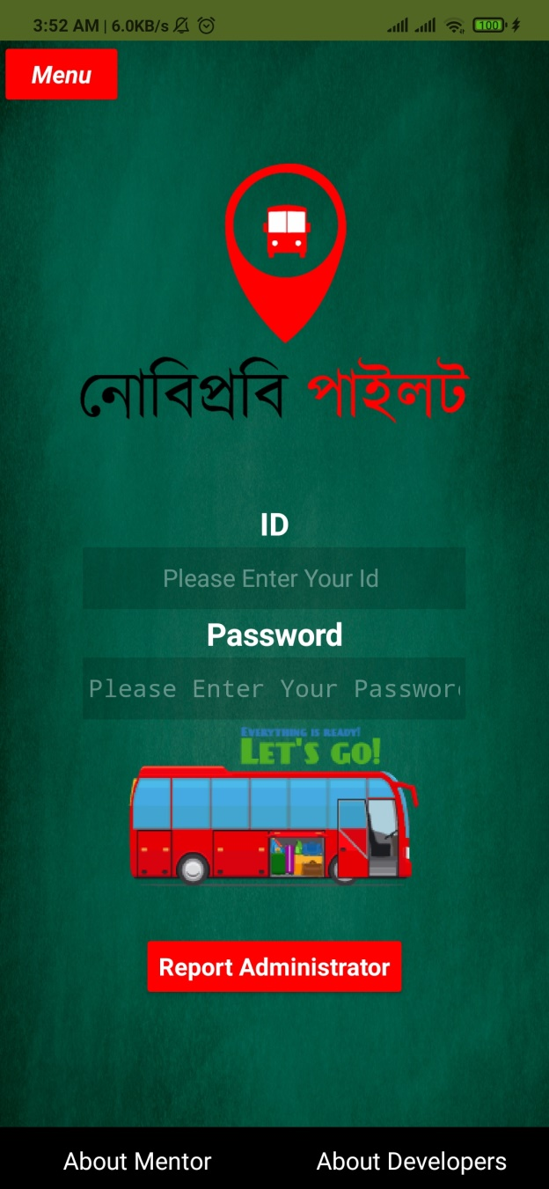
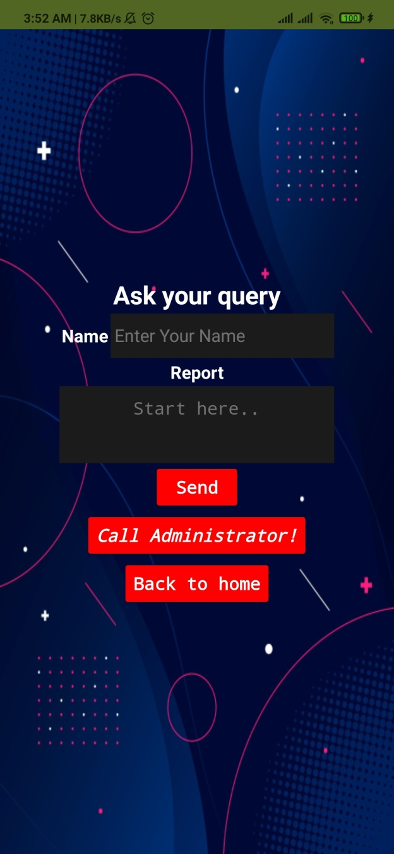
‘User Manual’
(Bus Driver)Perspective

Slide 27
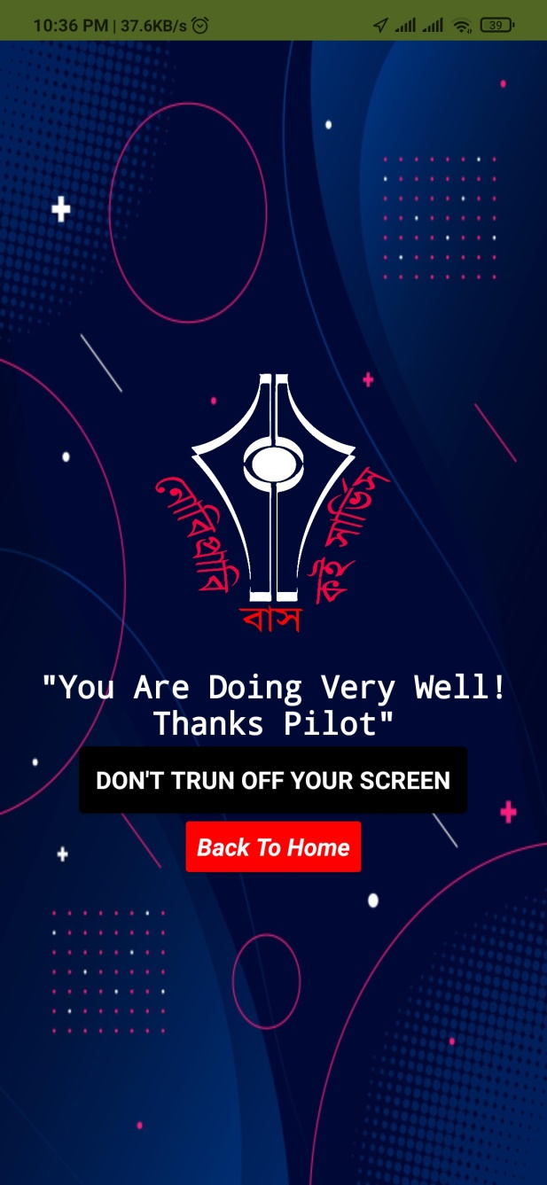
‘User Manual’
(Bus Driver)Perspective

Slide 28
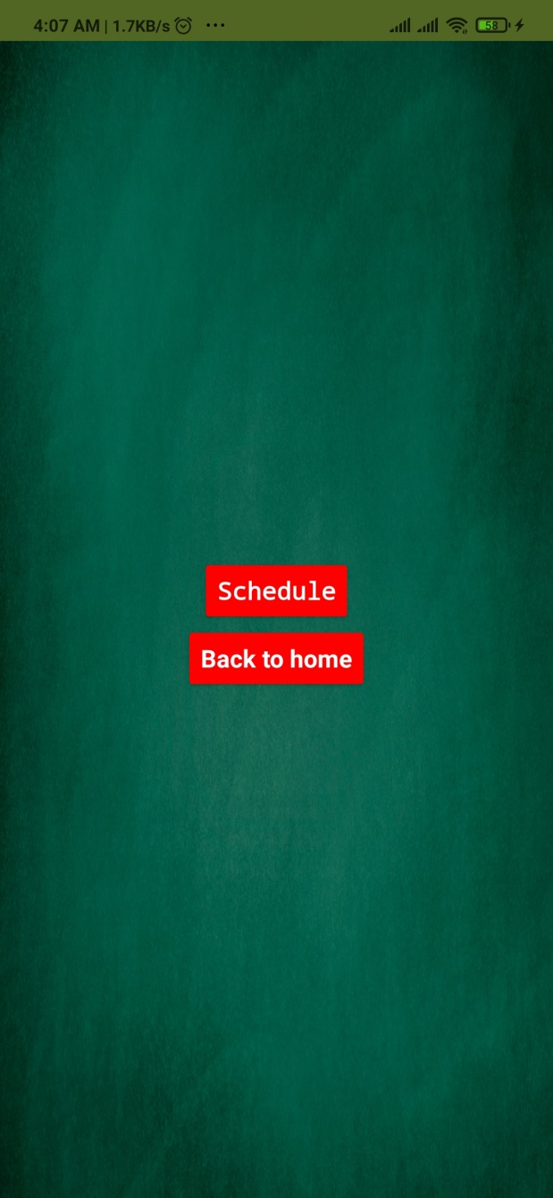
‘User Manual’
(Bus Driver)Perspective

Slide 29
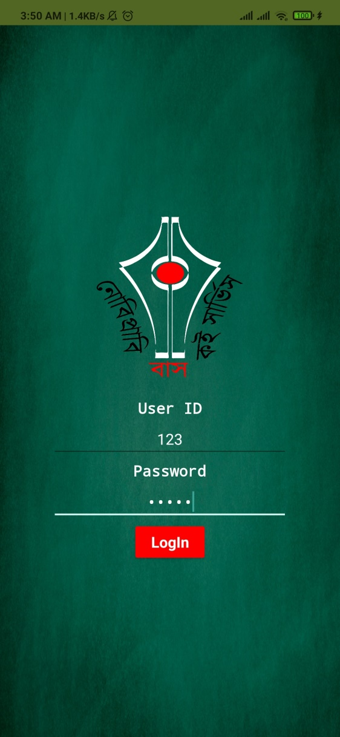
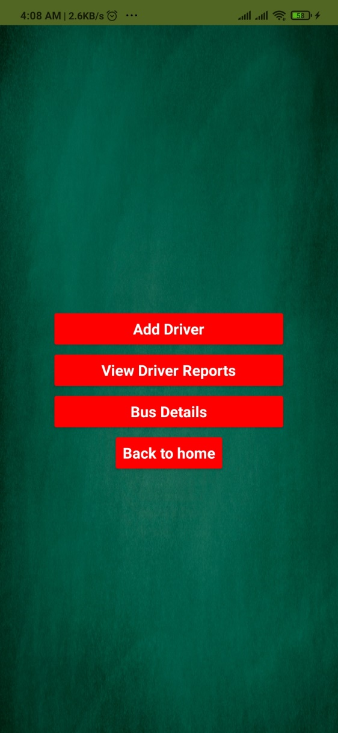
‘User Manual’
(Admin)Perspective

Slide 30
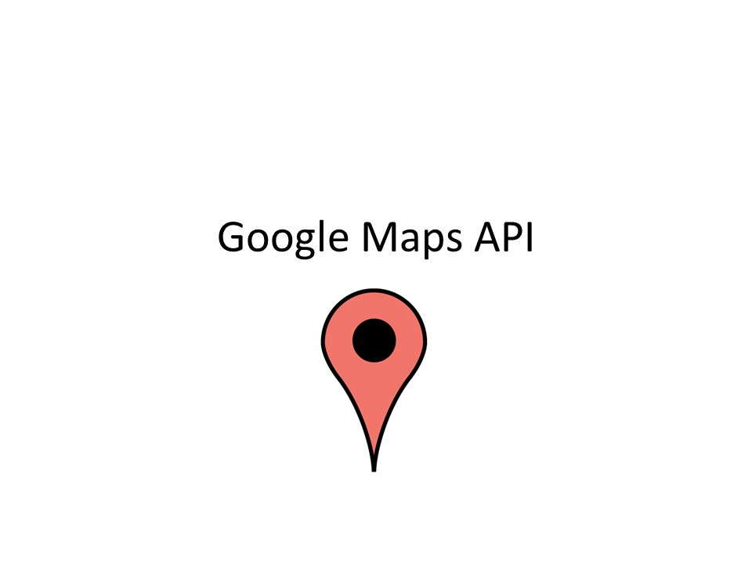
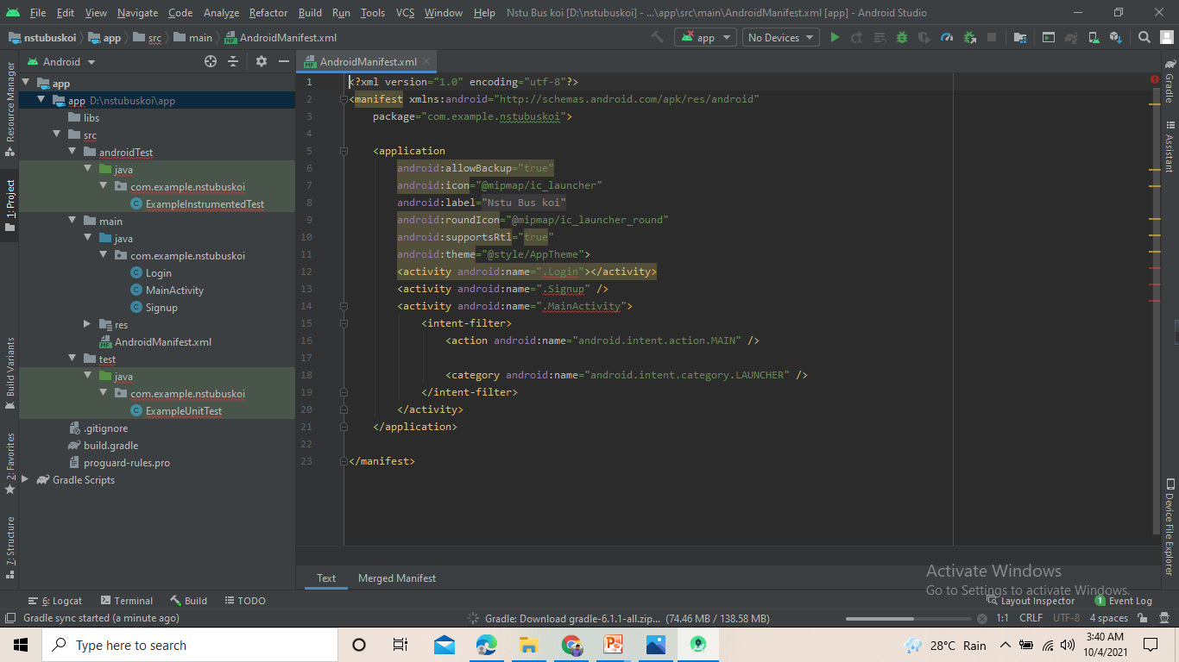

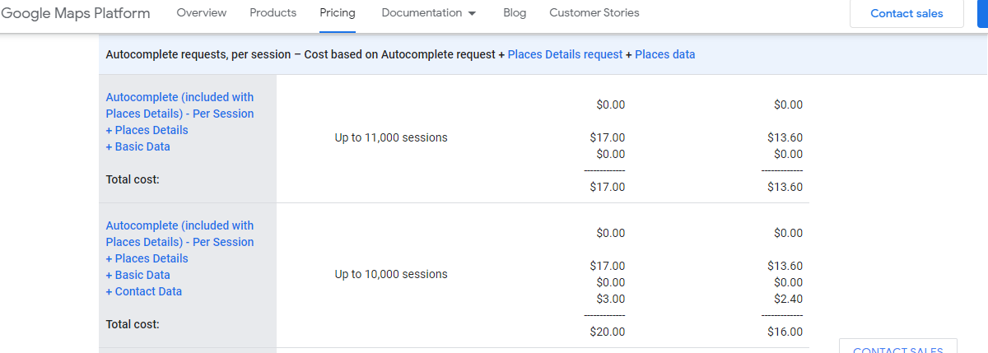
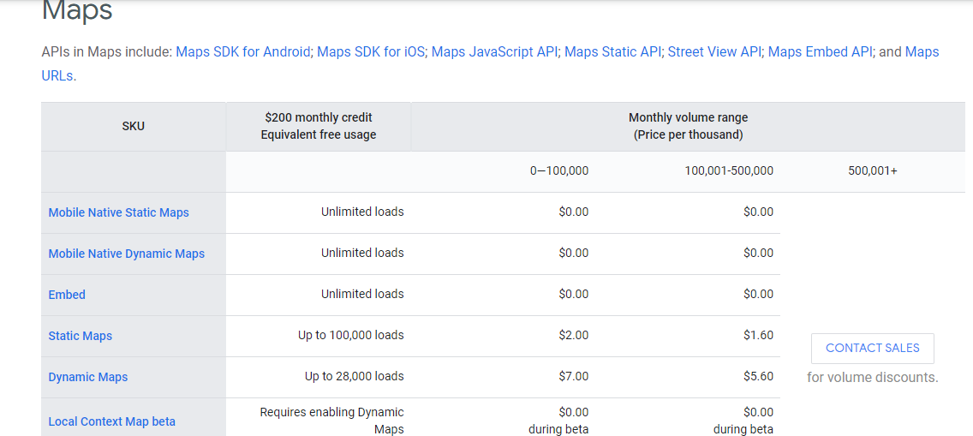
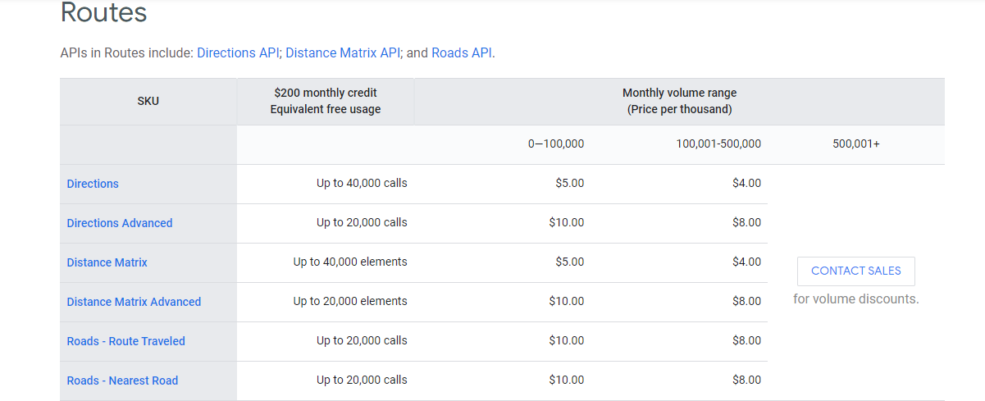


Facing Problem
Overall 200$ Need

Slide 31
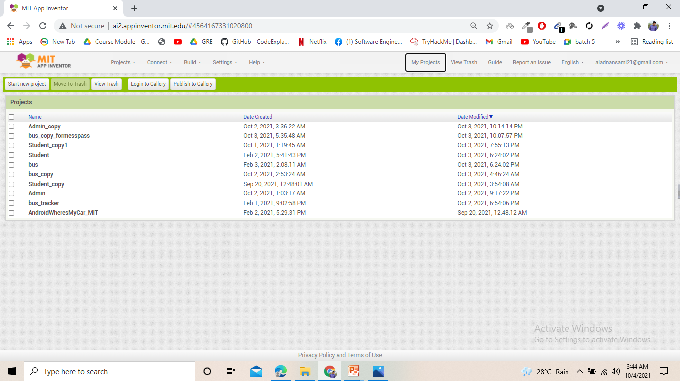
31

Slide 32

Limitation
01
There is no paid Google maps API
(Navigation Issue)
02
No Paid API (Multiple bus tracking Problem)
03
04
Less Security Protection
Non-Paid Database
32

Slide 33

Future Plan
Enhanced and Rich UI will be Designed.
We will add more features to improve our project.
2021
There will be use paid firebase database for security.
2021
2022
We will buy Google map API for navigation and multiple bus location tracking.
We will implement our project in real life.
2022
33

Slide 34
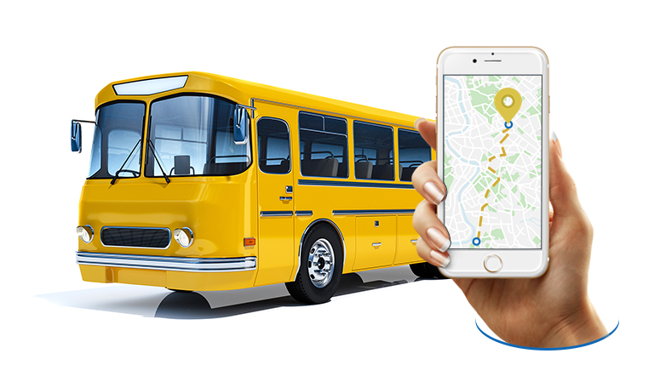


Software Design(Deliverables)
User Manual
SRS
Apps Apk
Apps Aia File

Slide 35


